Slide 1

Indian Statistical Institute, Delhi
ANALYSIS OF OCTANE RATING
Presented by:
Vicky Gupta
Mainack Paul
Goda Venkata Adithya Tarun

Slide 2
Amount of Material 1
Manufacturing Condition Rating
Octane Rating
Amount of Material 2
Amount of Material 3

Slide 3
Octane Rating
A standard measure of the ability of a fuel to withstand compression in an internal combustion engine without detonating. The higher the octane number, the more the fuel can withstand before detonating.
Aim
Of the available explanatory variables, find out which ones contribute significantly to the Octane Rating.
Remove the potential outliers from the dataset.
Fit a regression model that fits the data well.
Mean : 60.17061
Q1 : 55.21
Q2 : 62.695
Q3 : 68.0825
POP : 75, 76 & 77

Slide 4
Project Timeline
Identification and Removal of Potential Outliers
Fitting LSE
Goodness of Fit
01
02
03
04
05
06
07
Exploratory Data Analysis
Verification of Assumptions
Fitting LSE to Updated Data
Model Significance and Model Selection

Slide 5
Exploratory
Data Analysis
Critically performing initial investigations on data to discover patterns, anomalies using summary statistics and graphical representations

Slide 6
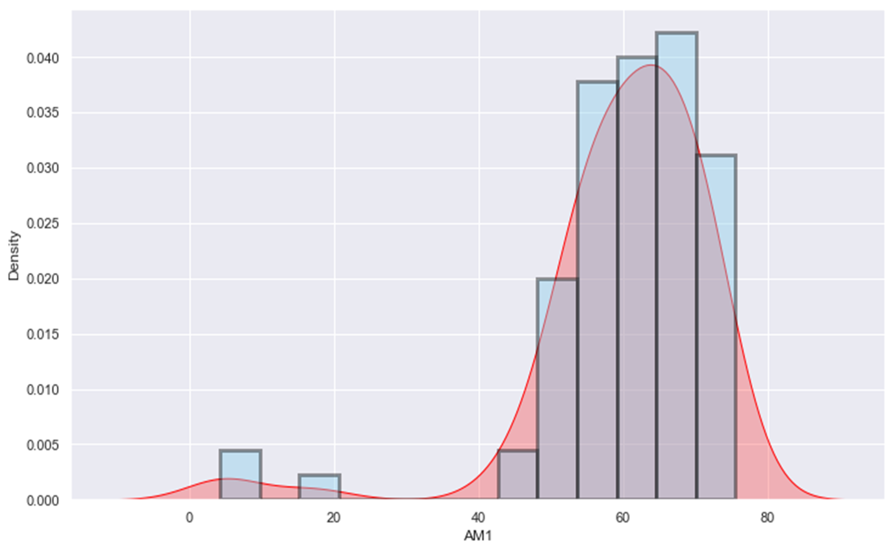
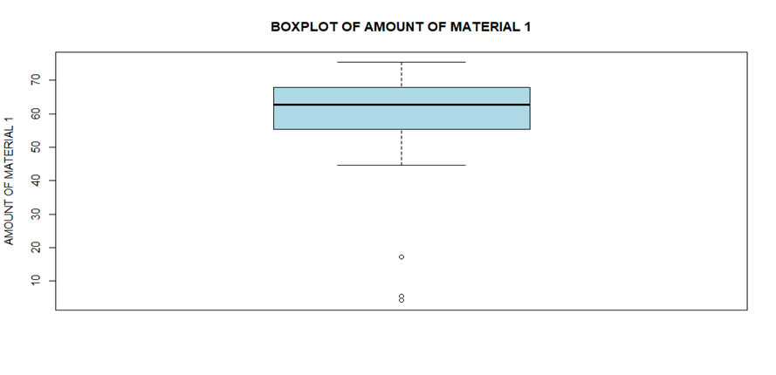
AMOUNT OF MATERIAL 1
A1
Mean : 60.17061
Q1 : 55.21
Q2 : 62.695
Q3 : 68.0825
POP : 75, 76 & 77

Slide 7
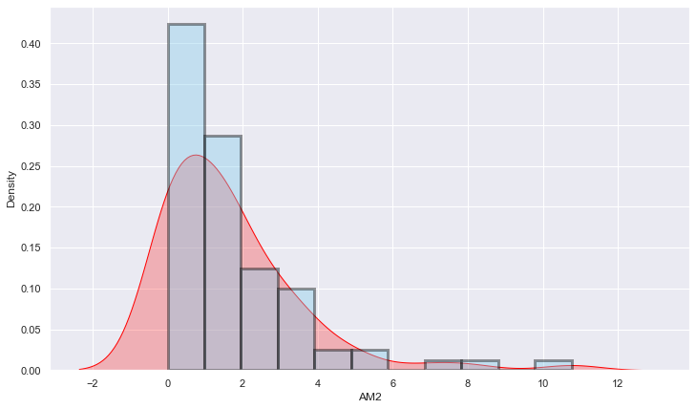
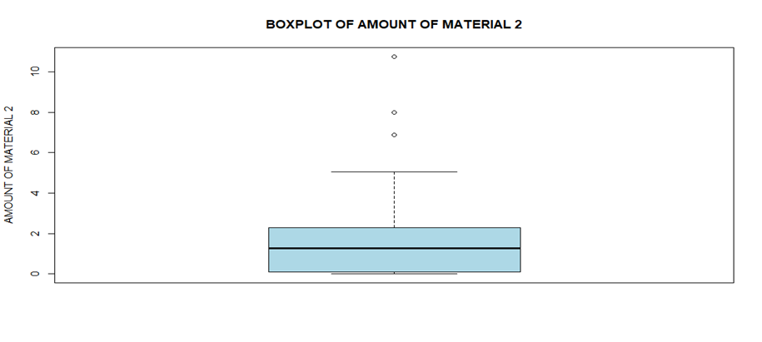
AMOUNT OF MATERIAL 2
A2
Mean : 1.663659
Q1 : 0.0975
Q2 : 1.28
Q3 : 2.295
POP : 44, 75 & 76

Slide 8
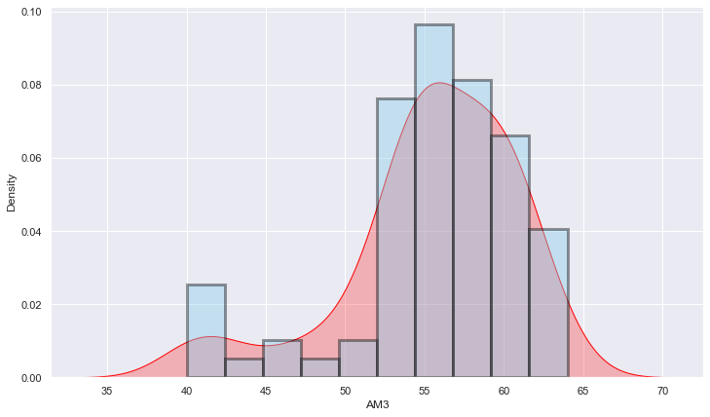
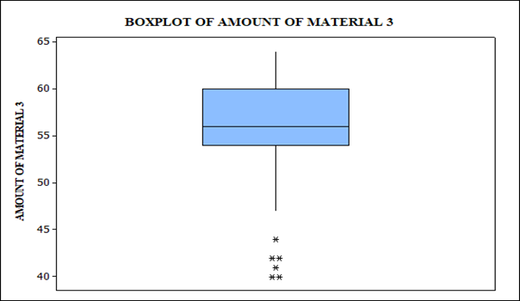
AMOUNT OF MATERIAL 3
A3
Mean : 55.46341
Q1 : 54
Q2 : 56
Q3 : 60
POP : 71 to 76

Slide 9
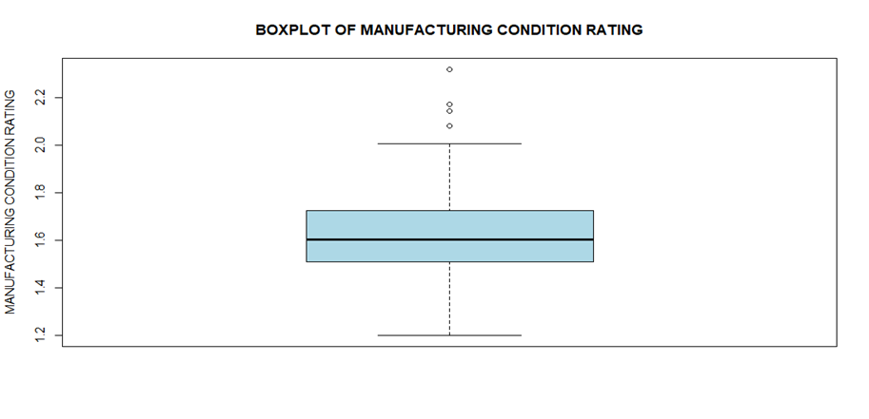
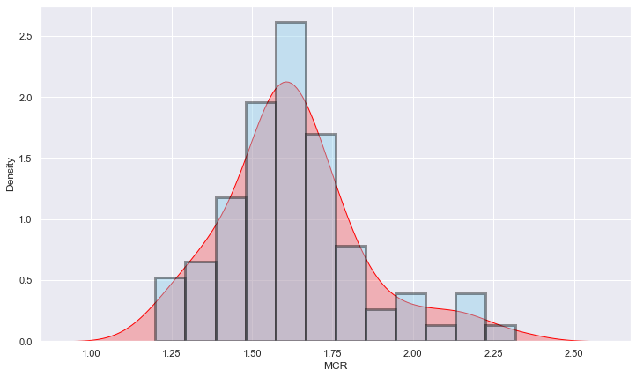
MANUFACTURING CONDITION RATING
A4
Mean : 1.626571
Q1 : 1.50744
Q2 : 1.60358
Q3 : 1.72422
POP : 71 to 74

Slide 10
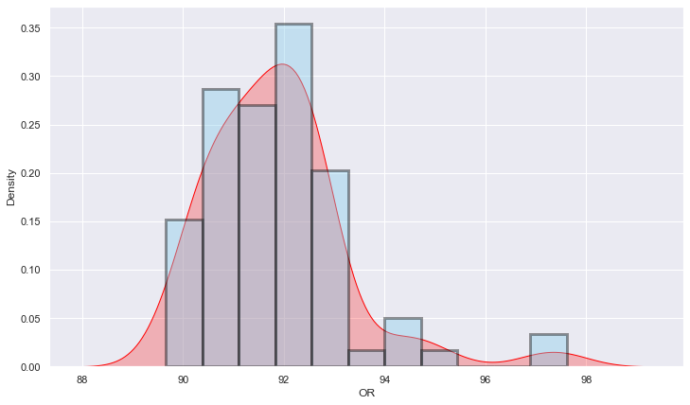
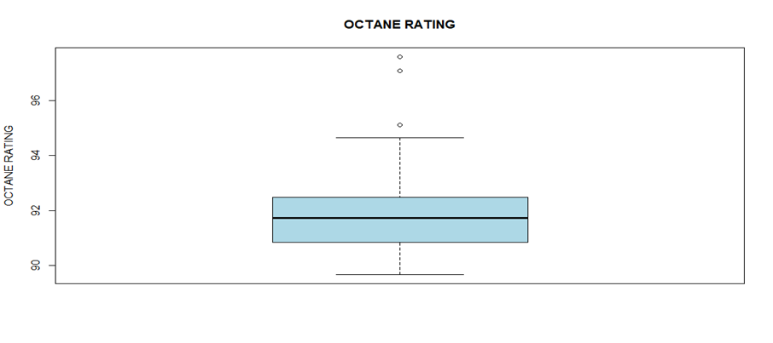
OCTANE RATING
OR
Mean : 91.84988
Q1 : 90.8125
Q2 : 91.735
Q3 : 92.4975
POP : 75, 76 & 77

Slide 11
Scatter Plot
OR vs. A1

Slide 12
Scatter Plot
OR vs. A2

Slide 13
Scatter Plot
OR vs. A3

Slide 14
Scatter Plot
OR vs. A4

Slide 15
Partial Residual Plot

Slide 16
Added Variable Plots

Slide 17
Added Variable Plots

Slide 18

Fitting Least Squares Model
“All models are wrong, but some are useful.”
-George E. P. Box

Slide 19
Assumptions
The regression model is linear in parameters
The regressors are fixed or measured without error
The mean of errors ε is zero
The errors and regressors are independent
The errors are homoscedastic
The errors are uncorrelated
There is no correlation between the regressors
The no. of observations is greater than no. of parameters
The error ε ~ MVN(0, σ²I_{n})

Slide 20

Fitted Linear Regression Model
Assuming the assumptions are satisfied, the fitted model is:
OR = 95.8531 - 0.0928*A1 - 0.1267*A2 - 0.0253*A3 + 1.9676*A4
Takeaways
p-Values
RSS = 15.00625
S² = 0.1948
R² = 0.9056
Adjusted R² = 0.9007
Intercept : < 2e-16
A1 : < 2e-16
A2 : 0.000176
A3 : 0.73160
A4 : 4.65e-08

Slide 21
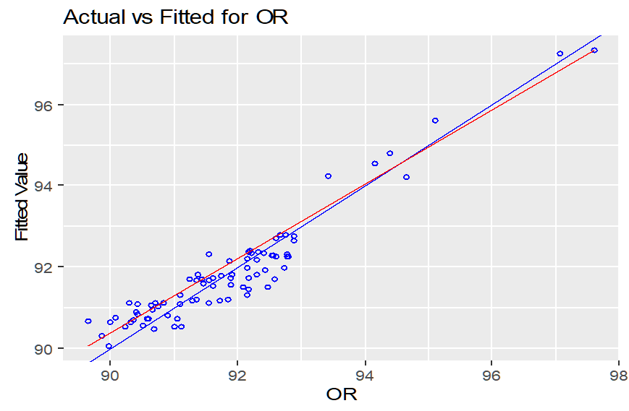
Actual vs. Fitted Values

Slide 22

Verification of Assumptions
“…there never was a straight line, yet with normal and linear assumptions, known to be false, he can often derive results which match…”
-George E. P. Box

Slide 23
Sequence of Verification
Normality of the errors
Homoscedasticity of errors
No Auto-Correlation in the Errors
Absence of Multicollinearity in Explanatory Variables

Slide 24
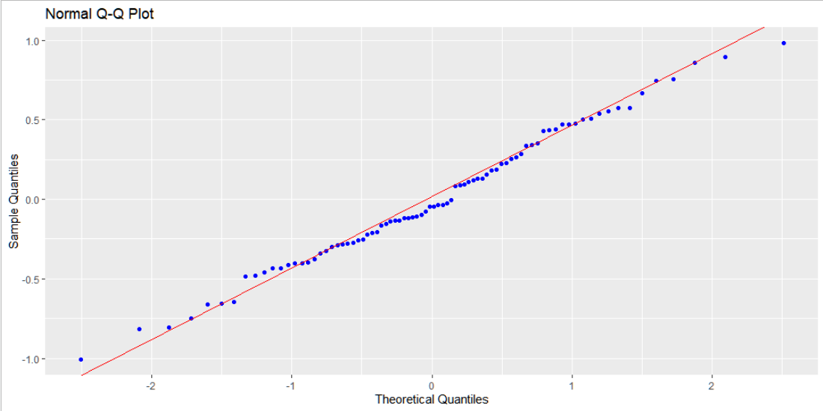
Normality of Errors
Q-Q Plot

Slide 25
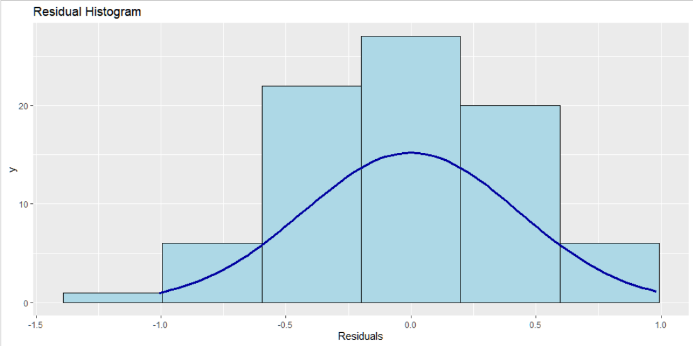
Normality of Errors
Histogram and Density Plot

Slide 26
Normality of Errors
Shapiro - Wilk Test
Null hypothesis:
The errors follow normal distribution
Alternative Hypothesis:
The errors does not follow normal distribution
The calculated W = 0.98902
p – Value = 0.7176

Slide 27
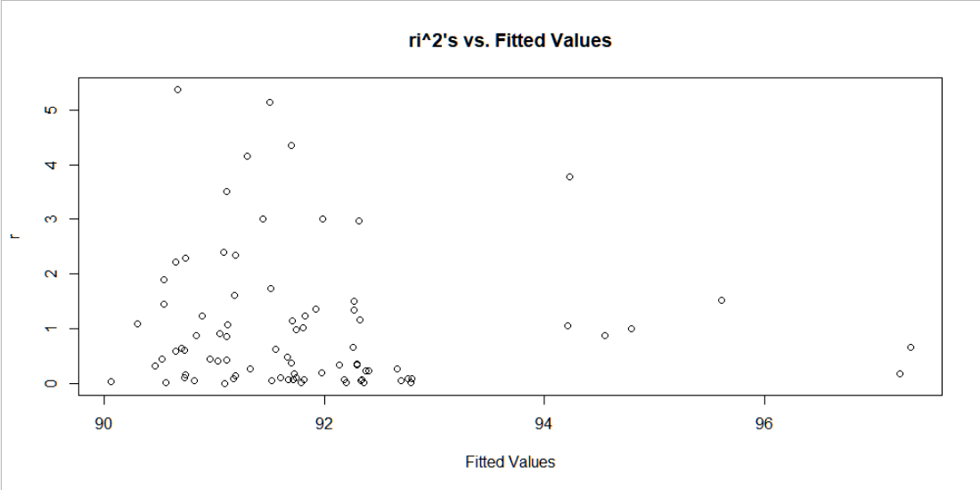
Homoscedasticity of Errors
Plot of r_{i}²s’ vs. Fitted Values

Slide 28
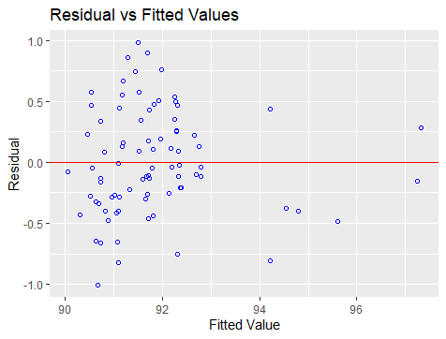
Homoscedasticity of Errors
Residuals vs. Fitted Values

Slide 29
Homoscedasticity of Errors
Breusch - Pagan Test
Null hypothesis:
Errors are homoscedastic
Alternative Hypothesis:
Errors are heteroscedastic
The calculated BP = 2.8947
p – Value = 0.5756

Slide 30
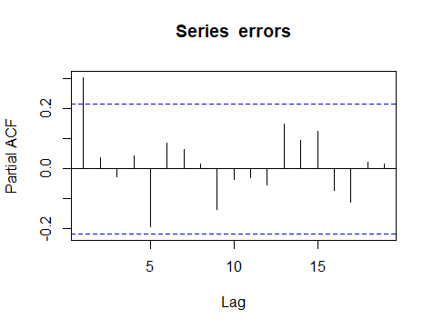
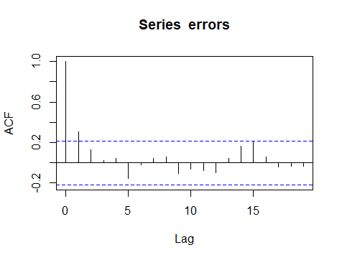
Auto-Correlation of Errors
ACF PACF

Slide 31
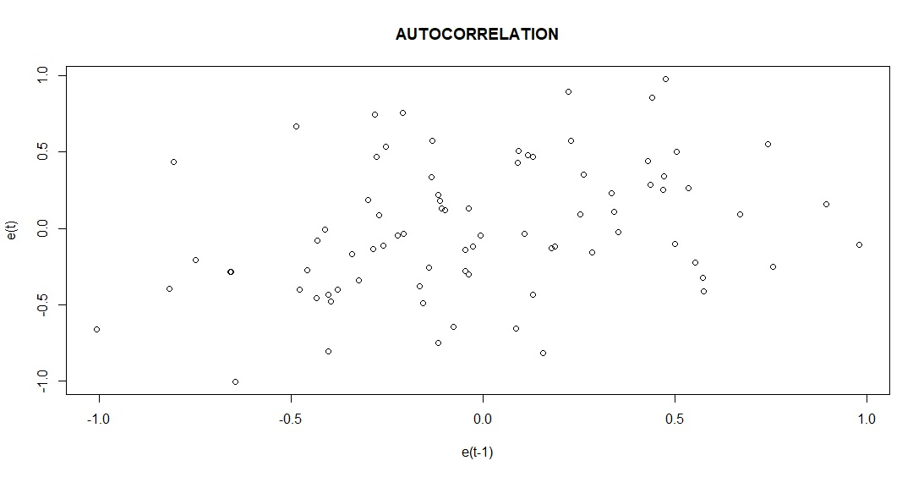
Auto-Correlation of Errors
Durbin – Watson Test
Under the assumption that the errors follow Markov model: Durbin – Watson Statistic d = 1.34
dl = 1.53 ; du = 1.74
d < dl, so errors might have positive auto-correlation.
Time Ordering
For n = 82 & p-1 = 4 at 5% level of significance

Slide 32
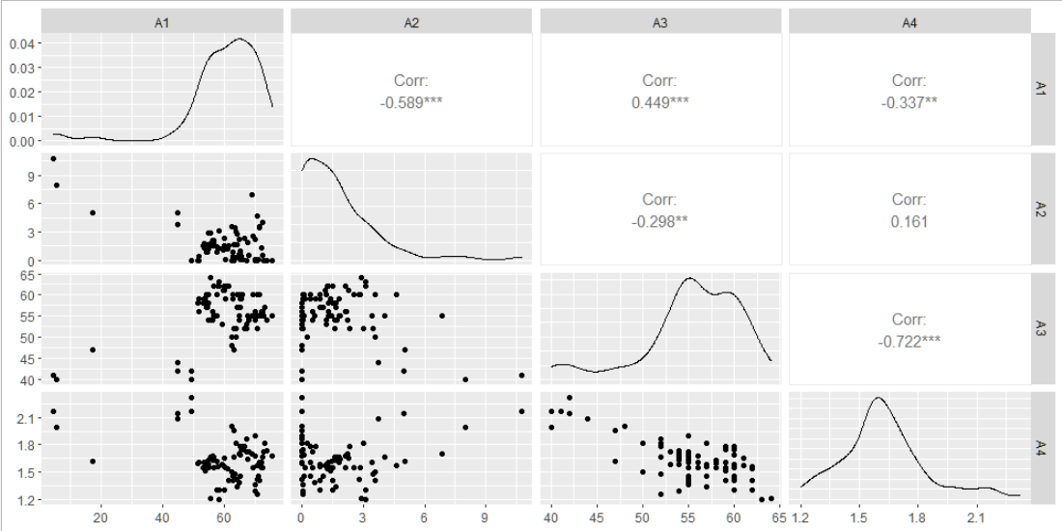
Multicollinearity
Scatter Plot

Slide 33
Multicollinearity
Partial Correlation Matrix
A1
A2
A3
A4
A1
1.000
-0.537
0.205
-0.077
A2
-0.537
1.000
-0.109
-0.110
A3
0.205
-0.109
1.000
-0.682
A4
-0.077
-0.110
-0.682
1.000

Slide 34

Multicollinearity
Variance Inflation Factors
Condition Number
VIF ≥ 10, serious multicollinearity
5 ≤ VIF < 10, moderate multicollinearity
VIF < 5, no multicollinearity
CN ≥ 30, serious multicollinearity
10 ≤ VIF < 30, moderate multicollinearity
CN < 10, no multicollinearity
The variance inflation factors of the variables:
A1 : 1.762293
A2 : 1.554770
A3 : 2.346033
A4 : 2.114003
The Condition Number of the design matrix, i.e., the square root of ratio of largest and smallest eigen values of X’X is calculated to be:
2.95007

Slide 35
Summary
Errors are normally distributed.
Errors are homoscedastic.
Errors are positively auto-correlated in the given order.
Multicollinearity is absent in the explanatory data.

Slide 36

Goodness of Fit
“I could prove God statistically. Take the human body alone - the chances that all the functions of an individual would just happen is a statistical monstrosity.”
-George Gallup

Slide 37
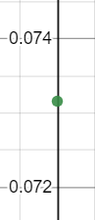
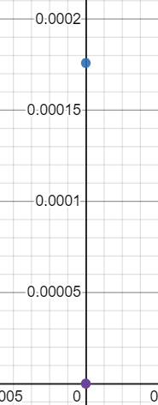
Significance Test
Goodness of Fit
A3
Each p – Value except that of A3 is less than 0.05, which implies each variable except A3 is significant.
R²
Adjusted R²
90.56%
90.07%
A2
Percentage of variation in the response explained by the explanatory variables
Percentage of variation in the response explained by the independent variables
A1
A4
Intercept

Slide 38
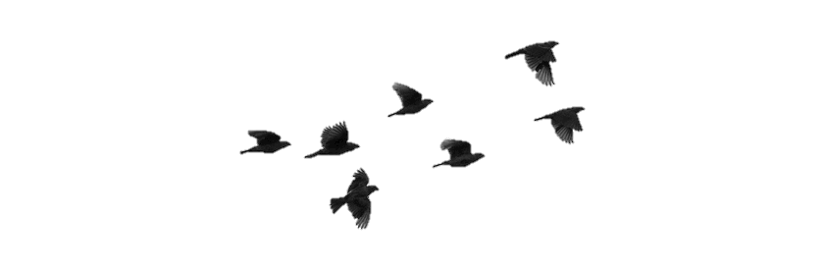
Potential
Outlier Points
“All statistics have outliers”
-Nenia Campbell

Slide 39
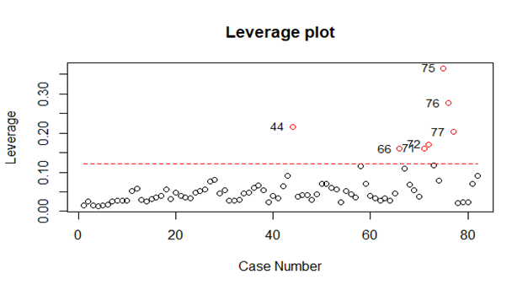
High-Leverage Points
Hat Matrix Diagonals with cutoff 0.122

Slide 40
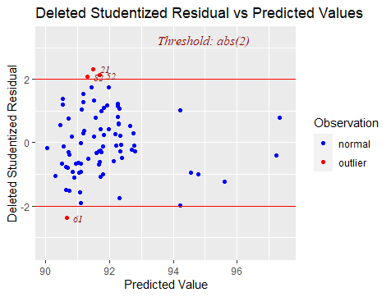
Outlier Points
Externally Studentized Residuals

Slide 41
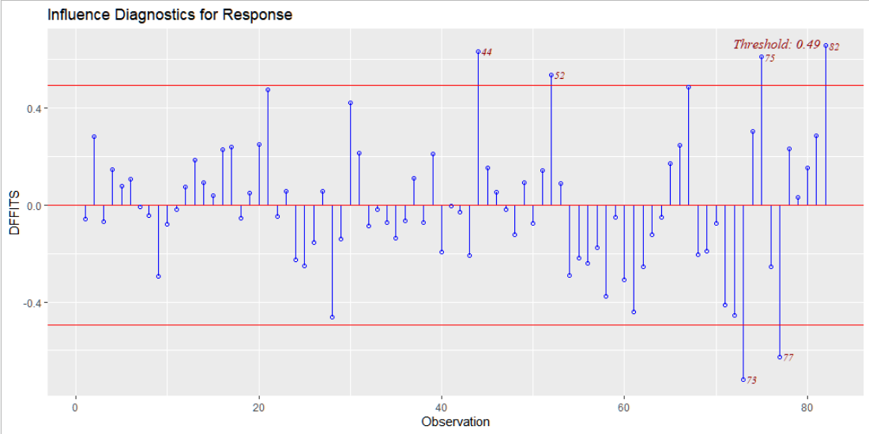
High-Influence Points
DFFITS

Slide 42
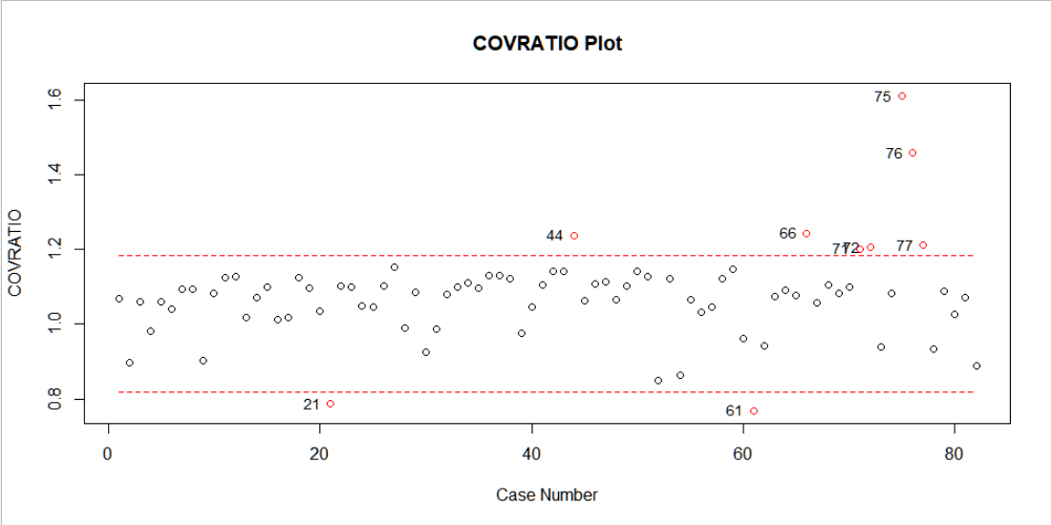
High-Influence Points
Covariance Ratio

Slide 43
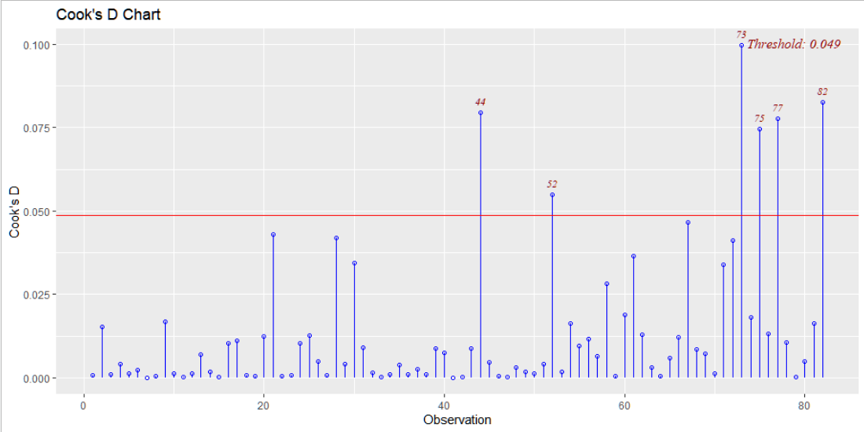
High-Influence Points
Cook’s Distance

Slide 44
Outlier Test
Identified Cases
Case Index | 21 | 44 | 52 | 61 | 66 | 71 | 72 | 73 | 75 | 76 | 77 | 82
Frequency | 2 | 4 | 3 | 2 | 2 | 2 | 2 | 2 | 4 | 2 | 4 | 3
Suspicious cases are : 44, 52, 71, 72, 73, 75, 76, 77, 82
Using Outlier Shift Model -
The calculated F statistic = 2.995
Tabulated F_{(9,68)}(0.95) = 2.0207
"The suspicious points are outliers by F-test"

Slide 45
After the Removal of Outliers
01
Update the dataset by removing the suspicious cases
02
Scatter Plots
03
Partial Residual Plots
04
Added Variable Plots
05
Model Selection
06
Fit the linear regression model with the updated dataset
07
Verify all the assumptions again as we have updated the dataset
08
Test for the goodness of fit
09
Test for significance of model and model parameters

Slide 46
Scatter Plot
OR_N vs. AM1

Slide 47
Scatter Plot
OR_N vs. AM2

Slide 48
Scatter Plot
OR_N vs. AM3

Slide 49
Scatter Plot
OR_N vs. MCR

Slide 50
Partial Residual Plot

Slide 51
Added Variable Plots

Slide 52
Added Variable Plots

Slide 53
Model Selection
Index | N | Predictors | R – Square | Adj. R - Square | Mallow’s Cp | AIC | BIC/SBC
1 | 1 | AM1 | 0.5379 | 0.5314 | 124.4281 | 149.6190 | 156.4904
2 | 1 | MCR | 0.2373 | 0.2259 | 250.5056 | 186.2554 | 193.1268
3 | 1 | AM3 | 0.0890 | 0.0762 | 312.3373 | 199.1698 | 206.0412
4 | 1 | AM2 | 0.0180 | 0.0042 | 342.0412 | 204.6455 | 211.5169
5 | 2 | AM1 MCR | 0.7816 | 0.7754 | 24.3976 | 96.8919 | 106.0538
6 | 2 | AM1 AM3 | 0.7110 | 0.7028 | 53.9480 | 117.3422 | 126.5041
7 | 2 | AM1 AM2 | 0.5996 | 0.5882 | 100.5953 | 141.1542 | 150.3160
8 | 2 | AM2 MCR | 0.2413 | 0.2196 | 250.5884 | 187.8161 | 196.9779
9 | 2 | AM3 MCR | 0.2373 | 0.2156 | 252.2299 | 188.1924 | 197.3542
10 | 2 | AM2 AM3 | 0.0974 | 0.0716 | 310.8293 | 200.4952 | 209.6570
11 | 3 | AM1 AM2 MCR | 0.8147 | 0.8066 | 12.5734 | 86.9203 | 98.3726
12 | 3 | AM1 AM3 MCR | 0.8077 | 0.7993 | 15.4798 | 89.6054 | 101.0577
13 | 3 | AM1 AM2 AM3 | 0.7499 | 0.7391 | 39.6526 | 108.7780 | 120.2303
14 | 3 | AM2 AM3 MCR | 0.2417 | 0.2087 | 252.4197 | 189.7773 | 201.2296
15 | 4 | AM1 AM2 AM3 MCR | 0.8375 | 0.8279 | 5.0000 | 79.3049 | 93.0477

Slide 54
Model Selection

Slide 55
Fitted Linear Regression Model
Assuming the assumptions are satisfied, the fitted model is:
OR_N = 98.045 – 0.109*AM1 – 0.143*AM2 – 0.046*AM3 + 1.976*MCR
Takeaways
p-Values
RSS = 10.7463
S² = 0.2207
R² = 0.8376
Adjusted R² = 0.828
Intercept : < 2e-16
AM1 : < 2e-16
AM2 : 0.000744
AM3 : 0.002864
MCR : 6.84e-08

Slide 56
Fitted Regression Model
Observed vs. Fitted Values

Slide 57
Normality of Errors
Q-Q Plot

Slide 58
Normality of Errors
Histogram and Density Plot

Slide 59
Normality of Errors
Shapiro - Wilk Test
Null hypothesis:
The errors follow normal distribution
Alternative Hypothesis:
The errors do not follow normal distribution
The calculated W = 0.98783
p – Value = 0.7107

Slide 60
Homoscedasticity of Errors
Plot of r_{i}²s’ vs. Fitted Values

Slide 61
Homoscedasticity of Errors
Residuals vs. Fitted Values

Slide 62
Homoscedasticity of Errors
Breusch - Pagan Test
Null hypothesis:
Errors are homoscedastic
Alternative Hypothesis:
Errors are heteroscedastic
The calculated BP = 4.2423
p – Value = 0.3742

Slide 63
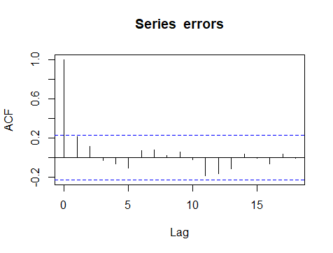
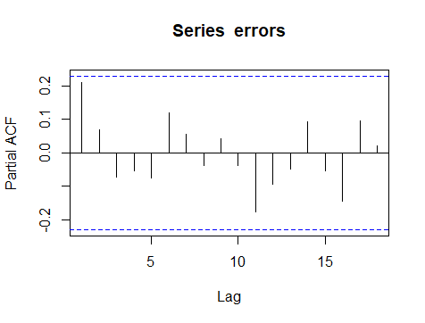
Auto-Correlation of Errors
ACF PACF

Slide 64
Auto-Correlation of Errors
Durbin – Watson Test
Under the assumption that the errors follow Markov model: Durbin – Watson Statistic d = 1.548
dl = 1.52 ; du = 1.74 for n = 73 & p-1 = 4 at 5% level of significance.
d_{l} ≤d ≤ d_{u}, so test is inconclusive for positive autocorrelation.
4-d > d_{u}, so the errors do not have negative autocorrelation or no serial correlation at all.

Slide 65
Auto-Correlation of Errors
Breusch – Godfrey Test
Under the assumption that the errors follow AR(q) scheme:
H₀: No auto-correlation of any order is present
H₁: Auto-correlation of some order is significantly present
The p-value of the Breusch – Godfrey test came out to be : 0.067
As p-value > 0.05, we do not reject the null hypothesis

Slide 66
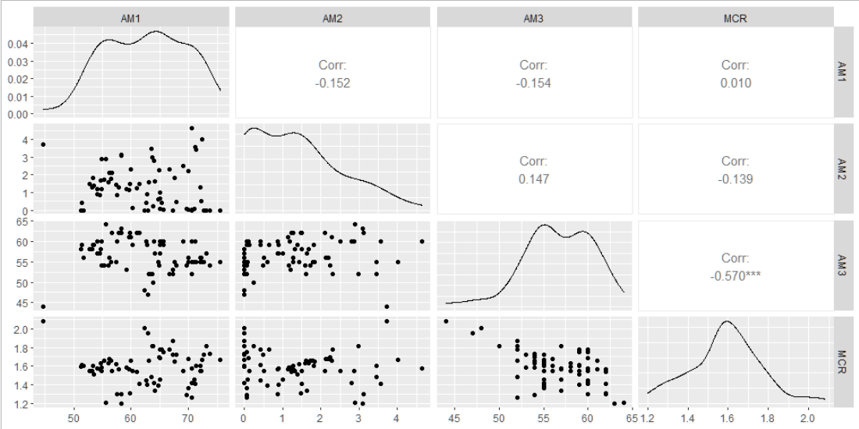
Multicollinearity
Scatter Plot

Slide 67
Multicollinearity
Partial Correlation Matrix
AM1
AM2
AM3
MCR
AM1
1.000
-0.139
-0.170
-0.106
AM2
-0.139
1.000
-0.057
-0.081
AM3
-0.170
-0.057
1.000
-0.568
MCR
-0.106
-0.081
-0.568
1.000

Slide 68
Multicollinearity
Variance Inflation Factors
Condition Number
VIF ≥ 10, serious multicollinearity
5 ≤ VIF < 10, moderate multicollinearity
VIF < 5, no multicollinearity
CN ≥ 30, serious multicollinearity
10 ≤ VIF < 30, moderate multicollinearity
CN < 10, no multicollinearity
The variance inflation factors of the variables:
AM1 : 1.054207
AM2 : 1.047070
AM3 : 1.535972
MCR : 1.504650
The Condition Number of the design matrix, i.e., the square root of ratio of largest and smallest eigen values of X’X is calculated to be:
2.015544

Slide 69
Summary
Errors are normally distributed.
Errors are homoscedastic.
Errors are not auto-correlated in the given order.
Multicollinearity is absent in the explanatory data.

Slide 70

Goodness of Fit
“This model will be a simplification and an idealization, and consequently a falsification. It is to be hoped that the features retained for discussion are those of greatest importance in the present state of knowledge.”
-Alan Turing

Slide 71
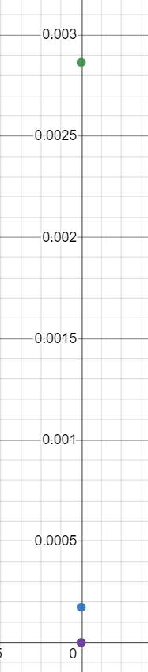
Significance Test
Goodness of Fit
AM3
Each p – Value is less than 0.05, which implies each variable is significant.
R²
Adjusted R²
83.76%
82.8%
AM2
Percentage of variation in the response explained by the explanatory variables
Percentage of variation in the response explained by the independent variables
AM1
MCR
Intercept

Slide 72
Resources
[1] Linear Regression Analysis 2nd edition[George A. F. Seber, Alan J. Lee]
[2] https://statanalytica.com/blog/how-to-perform-linear-regression-in-r-programming/
[3] https://www.investopedia.com/terms/m/multicollinearity.asp
[4] https://online.stat.psu.edu/stat501/lesson/12/12.1
[5] https://www.statology.org/heteroscedasticity-regression/
[6] https://www.ics.uci.edu/~jutts/110/Lecture3.pdf
[7] https://ebrary.net/1022/economics/detection_autocorrelation
[8] https://www.statology.org/breusch-pagan-test/
[9] http://www.statistics4u.info/fundstat_eng/ee_shapiro_wilk_test.html
[10] https://www.wikipedia.org/

Slide 73
Thank you!
Feel free to approach us if you have any questions.

